Slide 1

Rapid Application Development
Aurora

Slide 2

Introduce yourself (anything you want share)
Your goal -> Why are you here (for this course and for this program)

Slide 3
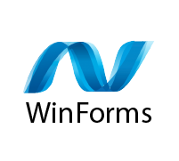

Learning Objective
Using WinForms framework, the learners will be able to build windows desktop application from UI to dynamic data.

Slide 4
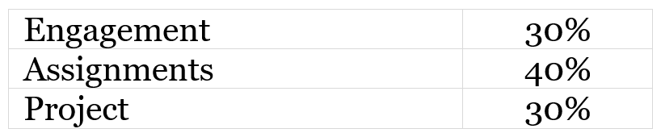
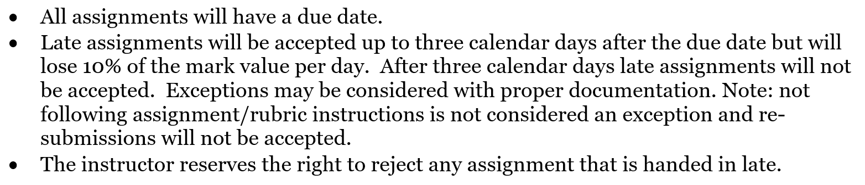
Outline
Modules – in D2L
Grades
Submission

Slide 5
Submission
For late submission, message me before due date only for emergency
DO NOT submit your work in Teams
Academic integrity

Slide 6


Class Agreement
Attend class (practice in class)
RESPECT with each other

Slide 7

Why
Why do we need windows desktop development?
Web development (Full Stack)
Mobile development (IOS, Android)
Windows desktop development?

Slide 8
Framework
Frameworks for windows desktop development
WinForms (Windows Forms)
WPF (Windows Presentation Foundation)
UWP (Universal Windows Platform)
……

Slide 9
Hello World Application
.Net version
“Windows Forms App” is for .Net 5 later.
“Windows Forms App (.NET Framework) ” is for .Net 4

